Slide 1
제29강 이미지출력 레이아웃 응용실습(1)
이미지 출력 앱과 출력 원리
이미지 출력
이미지 목록
그리드 형태의 이미지 출력

Slide 2
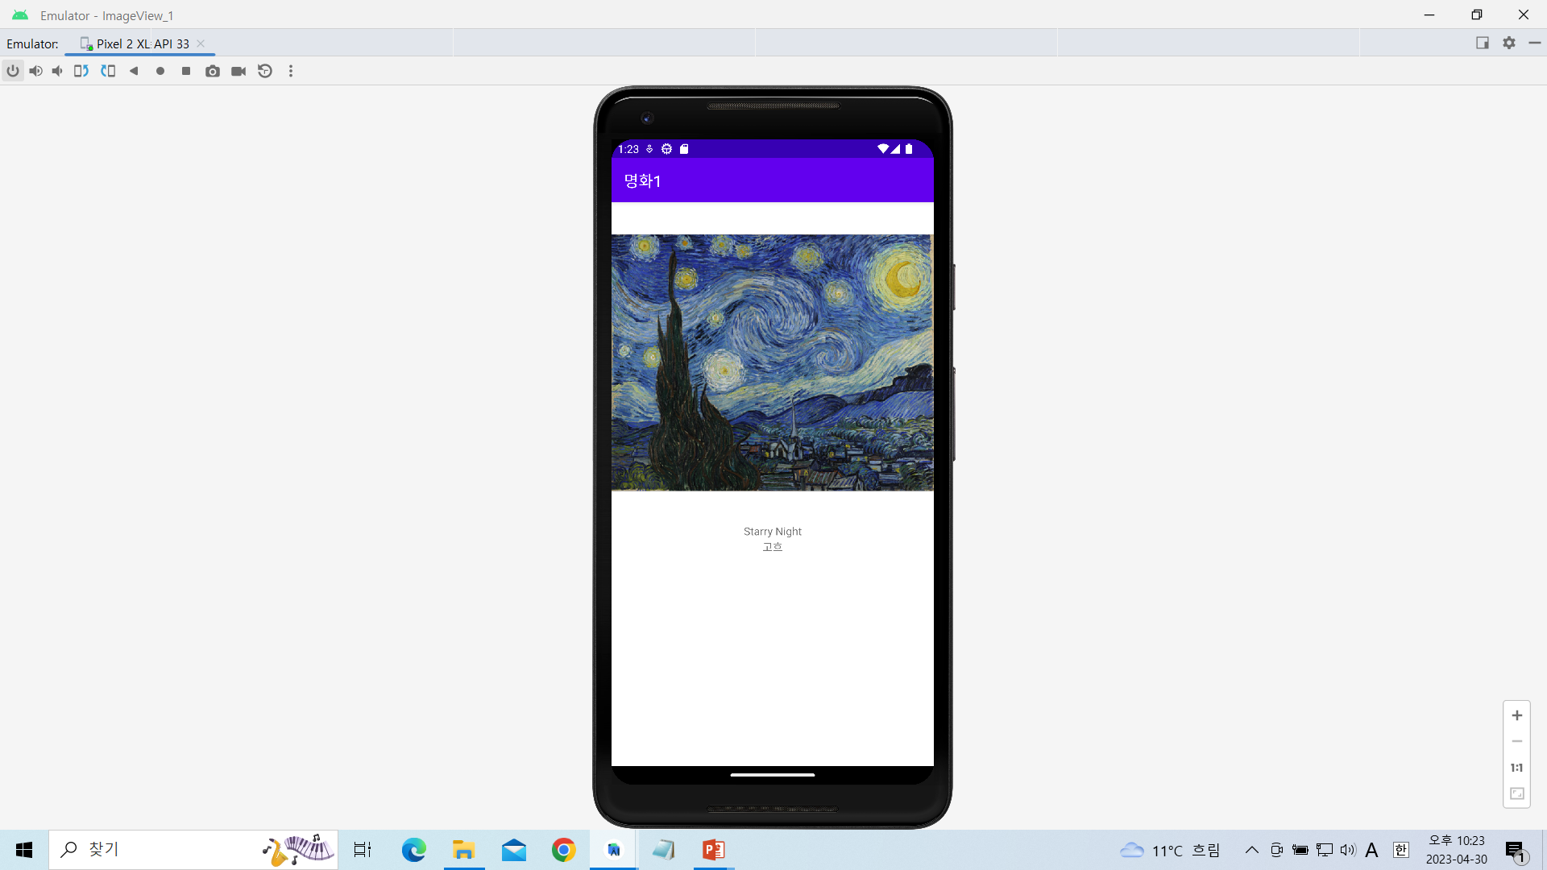
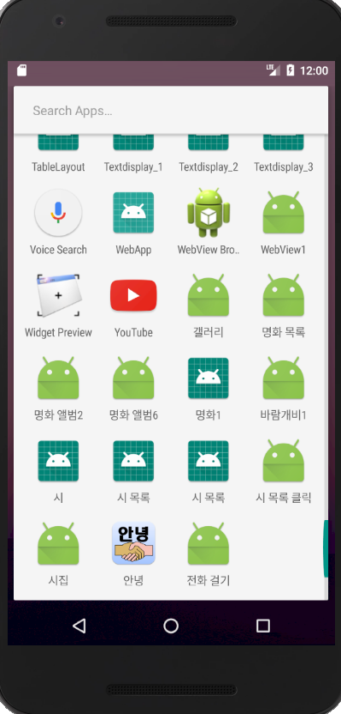
리니어 레이아웃을 이용한 이미지출력하기-1

Slide 3
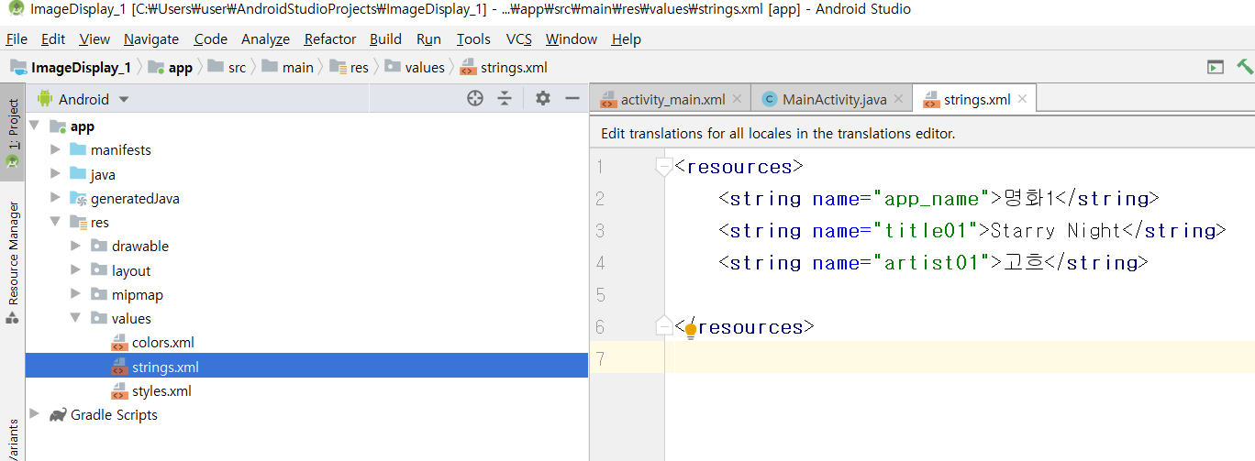
[strings.xml]
<resources>
<string name="app_name">명화1</string>
<string name="title01">Starry Night</string>
<string name="artist01">고흐</string>
</resources>

Slide 4
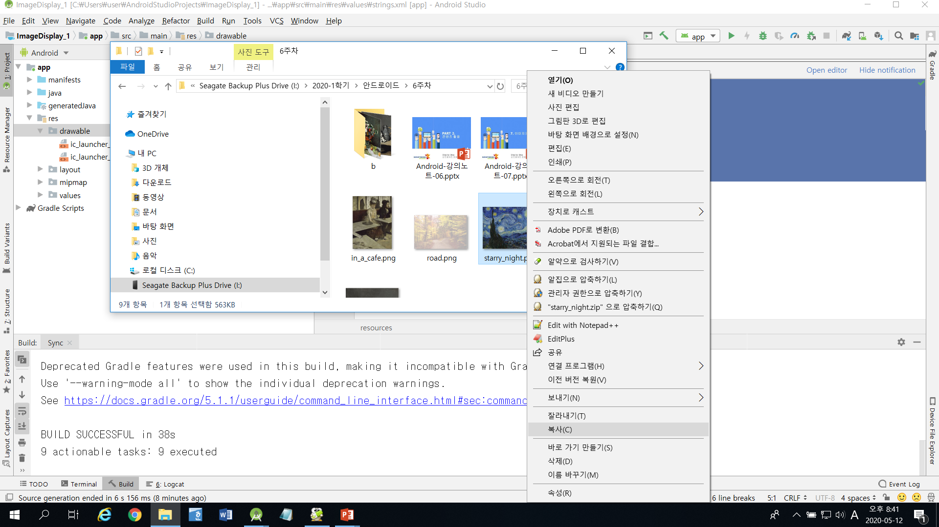
drawable 폴더에 이미지 삽입하기
해당 이미지 파일을 복사한 후 drawble 폴더에 paste한다.

Slide 5
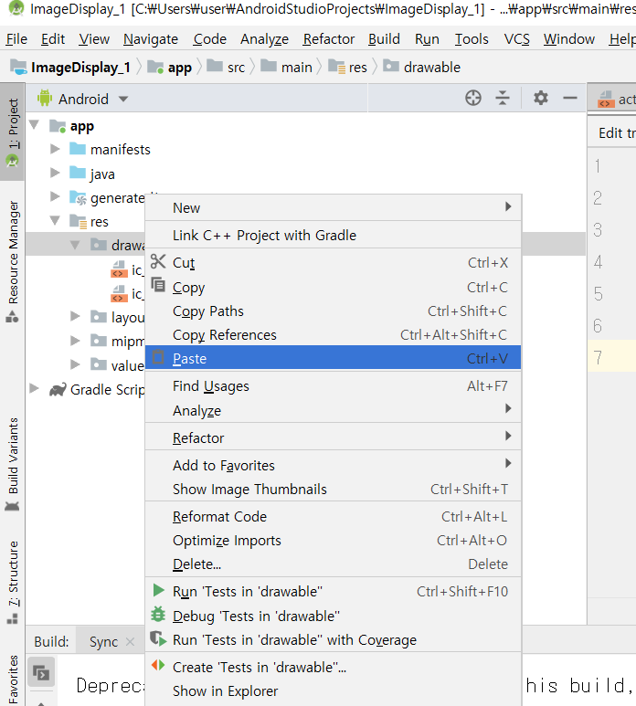
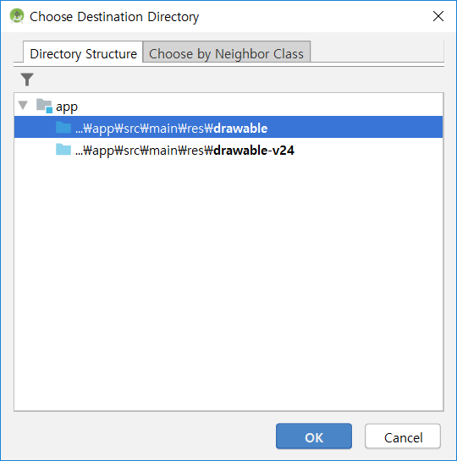
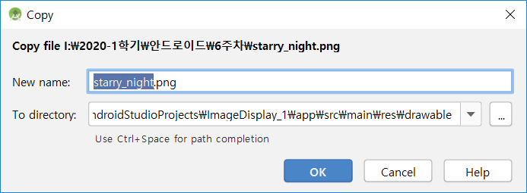

Slide 6
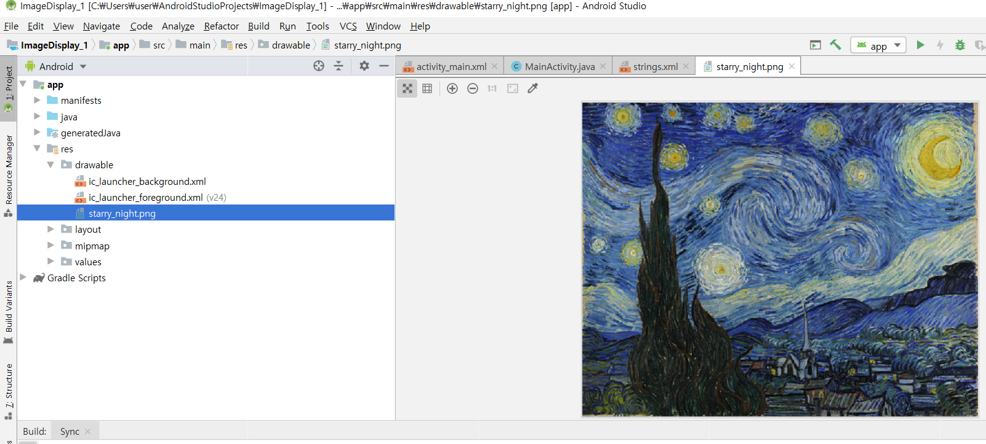

Slide 7
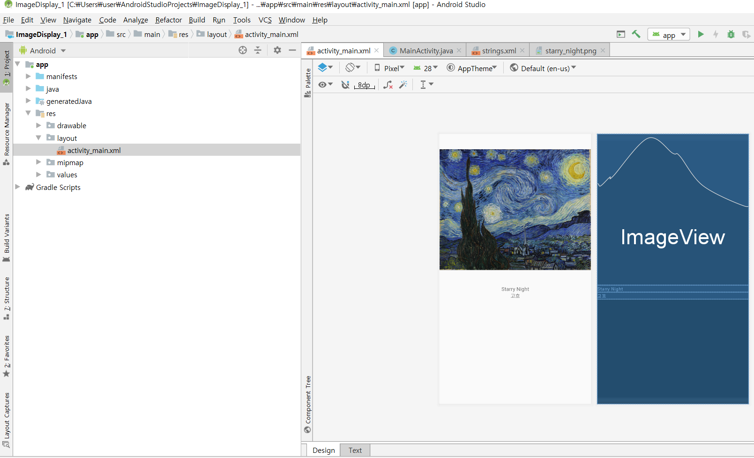
[activity_main.xml]

Slide 8
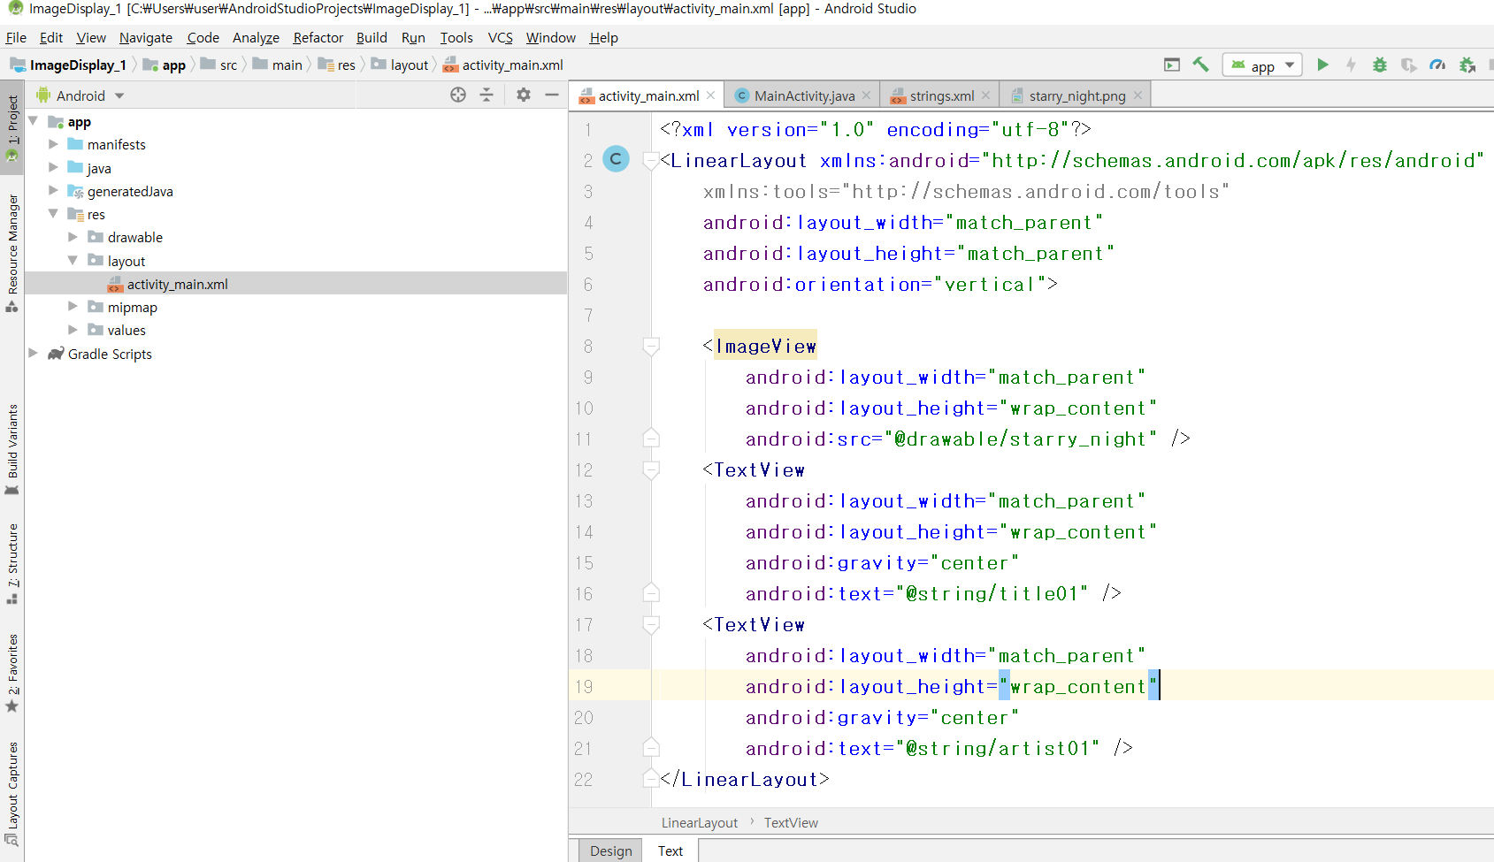

Slide 9
<?xml version="1.0" encoding="utf-8"?>
<LinearLayout xmlns:android="http://schemas.android.com/apk/res/android"
xmlns:tools="http://schemas.android.com/tools"
android:layout_width="match_parent"
android:layout_height="match_parent"
android:orientation="vertical">
<ImageView
android:layout_width="match_parent"
android:layout_height="wrap_content"
android:src="@drawable/starry_night" />
<TextView
android:layout_width="match_parent"
android:layout_height="wrap_content"
android:gravity="center"
android:text="@string/title01" />
<TextView
android:layout_width="match_parent"
android:layout_height="wrap_content"
android:gravity="center"
android:text="@string/artist01" />
</LinearLayout>

Slide 10
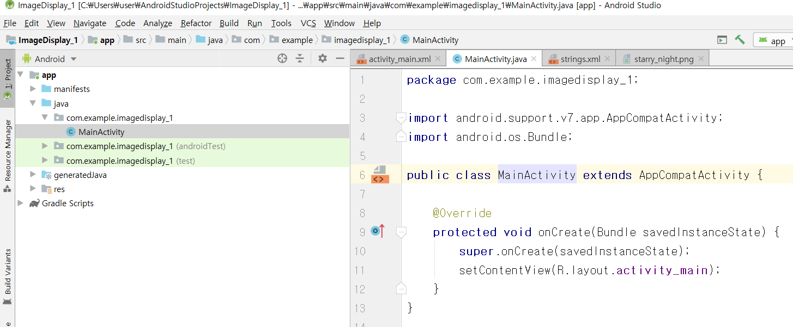
[MainActivity.java]

Slide 11
package com.example.imagedisplay_1;
import android.support.v7.app.AppCompatActivity;
import android.os.Bundle;
public class MainActivity extends AppCompatActivity {
@Override
protected void onCreate(Bundle savedInstanceState) {
super.onCreate(savedInstanceState);
setContentView(R.layout.activity_main);
}
}

Slide 12
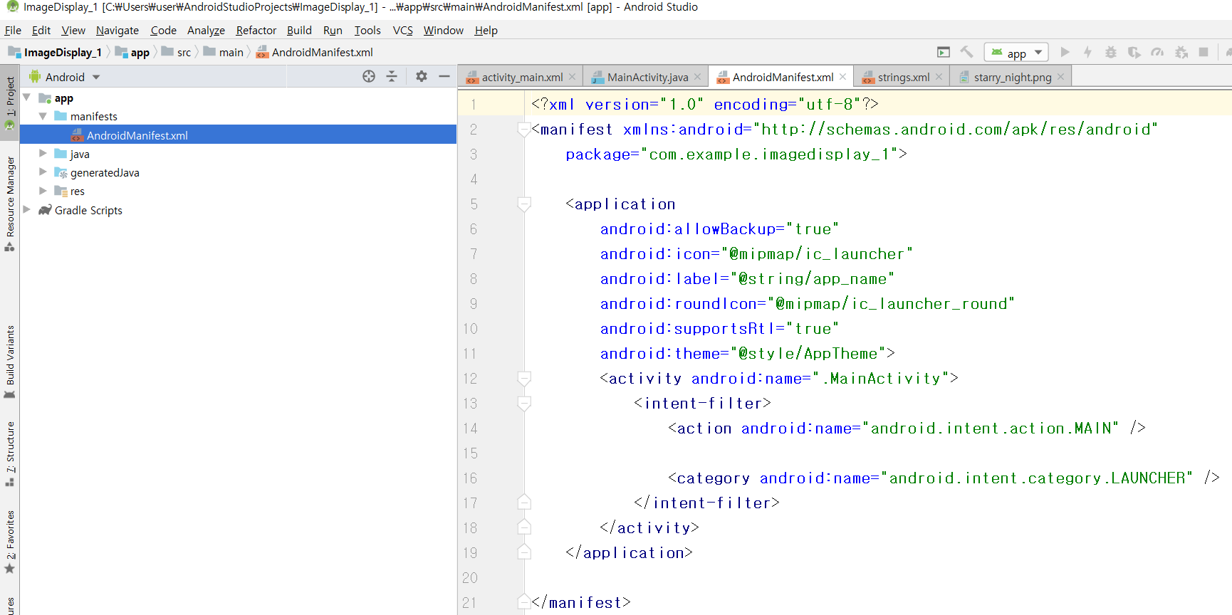
[AndroidManifest.xml]

Slide 13
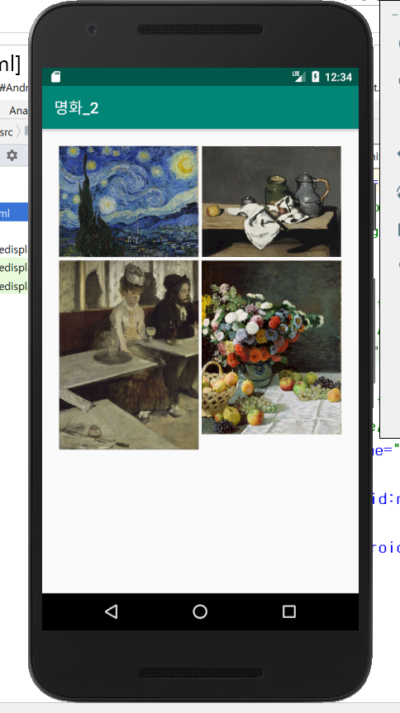
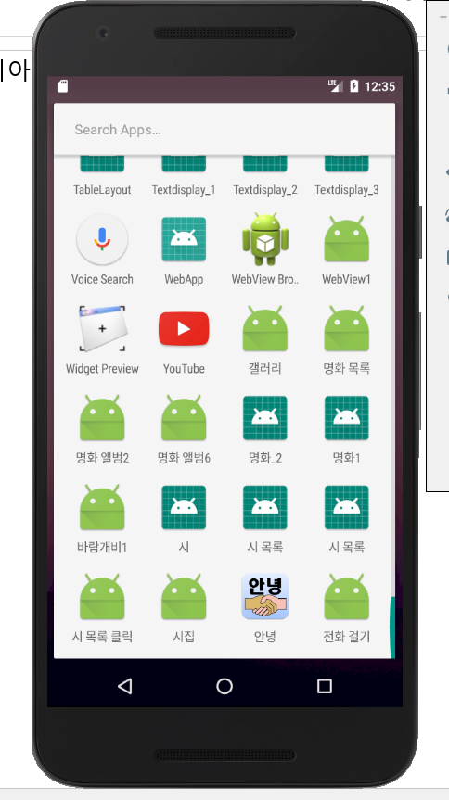
다중 리니어 레이아웃을 이용한 이미지출력하기-2

Slide 14
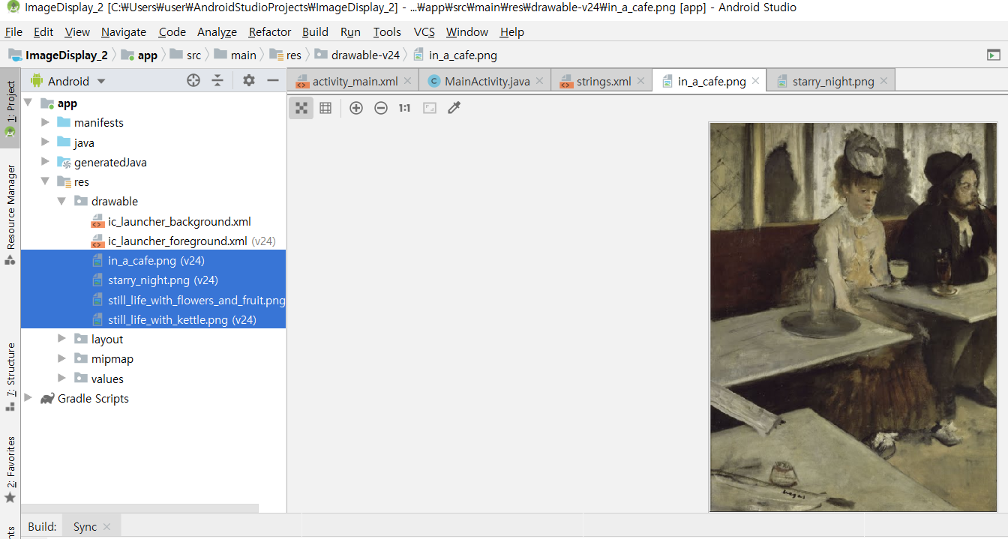
Drawable폴더에 4개의 이미지를 복사해 놓음

Slide 15
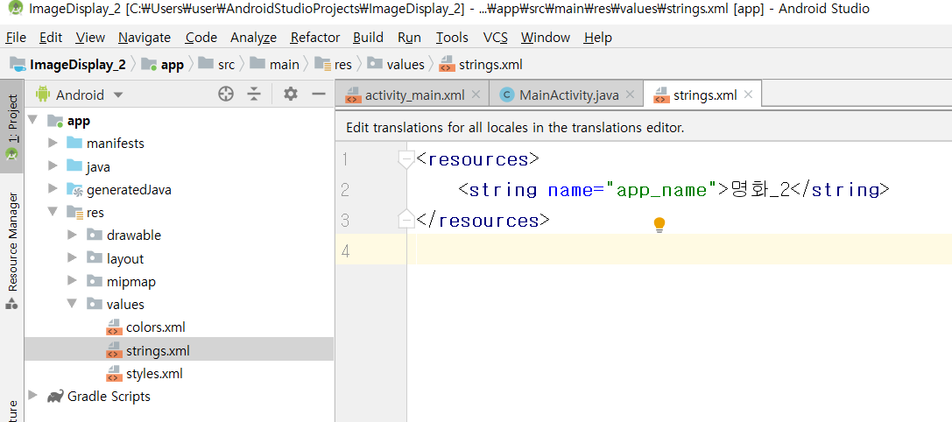
[strings.xml]
<resources>
<string name="app_name">명화_2</string>
</resources>

Slide 16
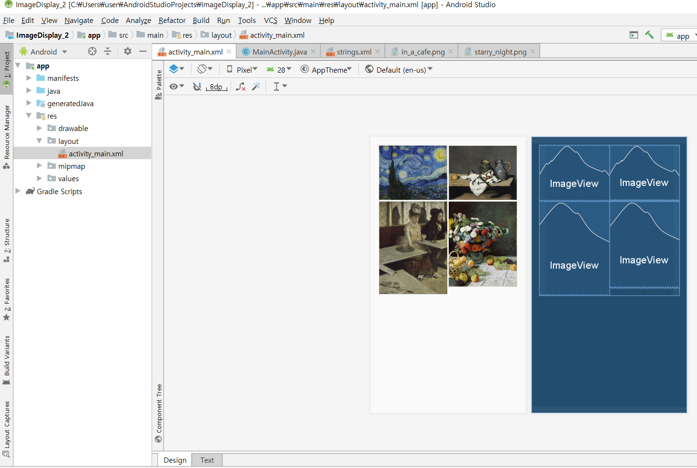
[activity_main.xml]

Slide 17
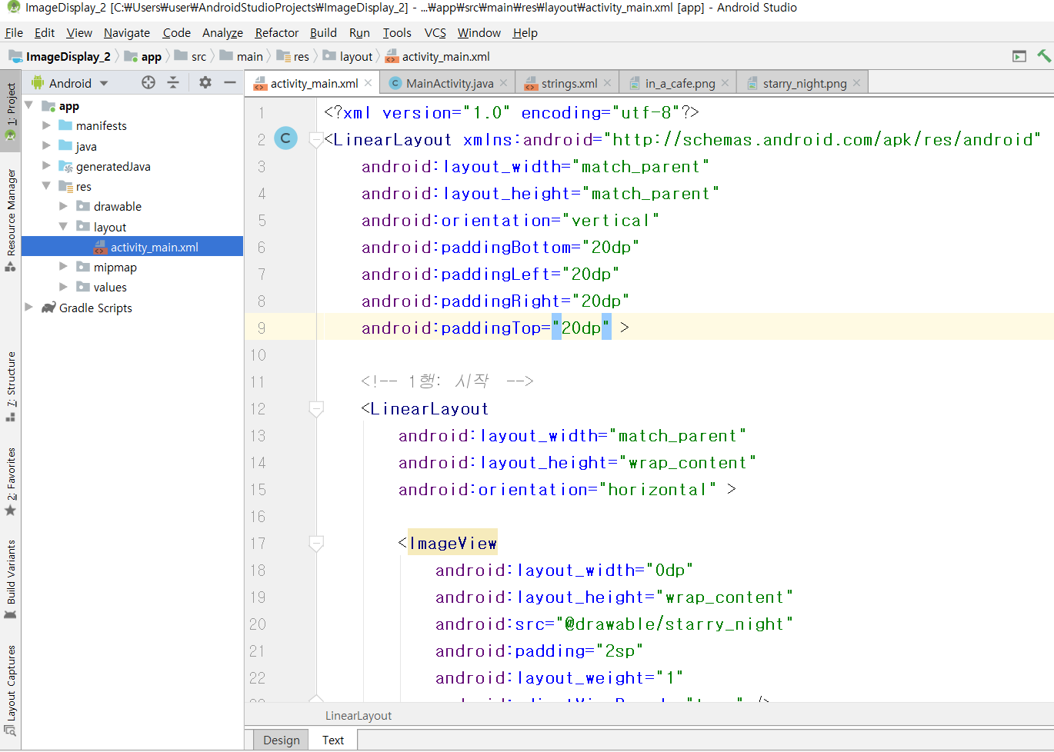

Slide 18
<?xml version="1.0" encoding="utf-8"?>
<LinearLayout xmlns:android="http://schemas.android.com/apk/res/android"
android:layout_width="match_parent"
android:layout_height="match_parent"
android:orientation="vertical"
android:paddingBottom="20dp"
android:paddingLeft="20dp"
android:paddingRight="20dp"
android:paddingTop="20dp" >
<!-- 1행: 시작 -->
<LinearLayout
android:layout_width="match_parent"
android:layout_height="wrap_content"
android:orientation="horizontal" >
<ImageView
android:layout_width="0dp"
android:layout_height="wrap_content"
android:src="@drawable/starry_night"
android:padding="2sp"
android:layout_weight="1"
android:adjustViewBounds="true" />
<ImageView
android:layout_width="0dp"
android:layout_height="wrap_content"
android:src="@drawable/still_life_with_kettle"
android:padding="2sp"
android:layout_weight="1"
android:adjustViewBounds="true" />
</LinearLayout>
<!-- 1행: 끝 -->

Slide 19
<!-- 2행: 시작 -->
<LinearLayout
android:layout_width="match_parent"
android:layout_height="wrap_content"
android:orientation="horizontal" >
<ImageView
android:layout_width="0dp"
android:layout_height="wrap_content"
android:src="@drawable/in_a_cafe"
android:padding="2sp"
android:layout_weight="1"
android:adjustViewBounds="true" />
<ImageView
android:layout_width="0dp"
android:layout_height="wrap_content"
android:src="@drawable/still_life_with_flowers_and_fruit"
android:padding="2sp"
android:layout_weight="1"
android:adjustViewBounds="true" />
</LinearLayout>
<!-- 2행: 끝 -->
</LinearLayout>

Slide 20
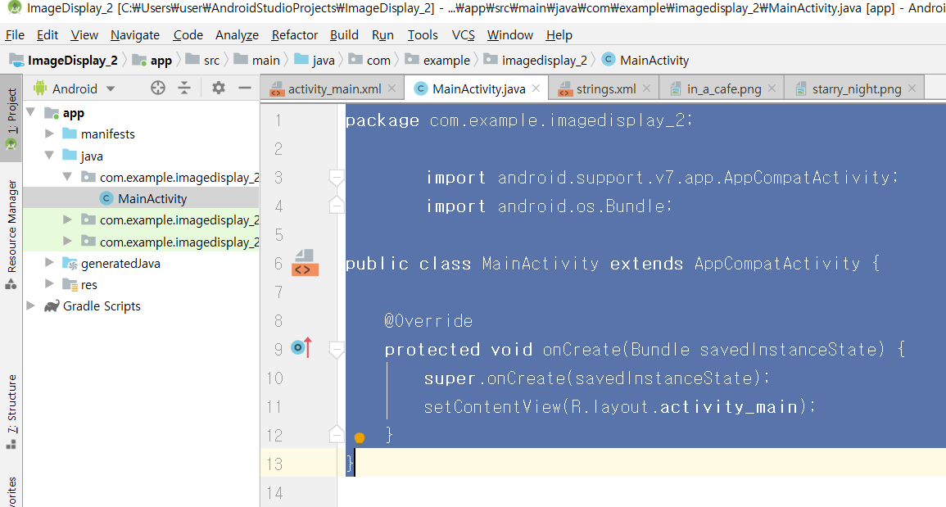
[MainActivity.java]

Slide 21
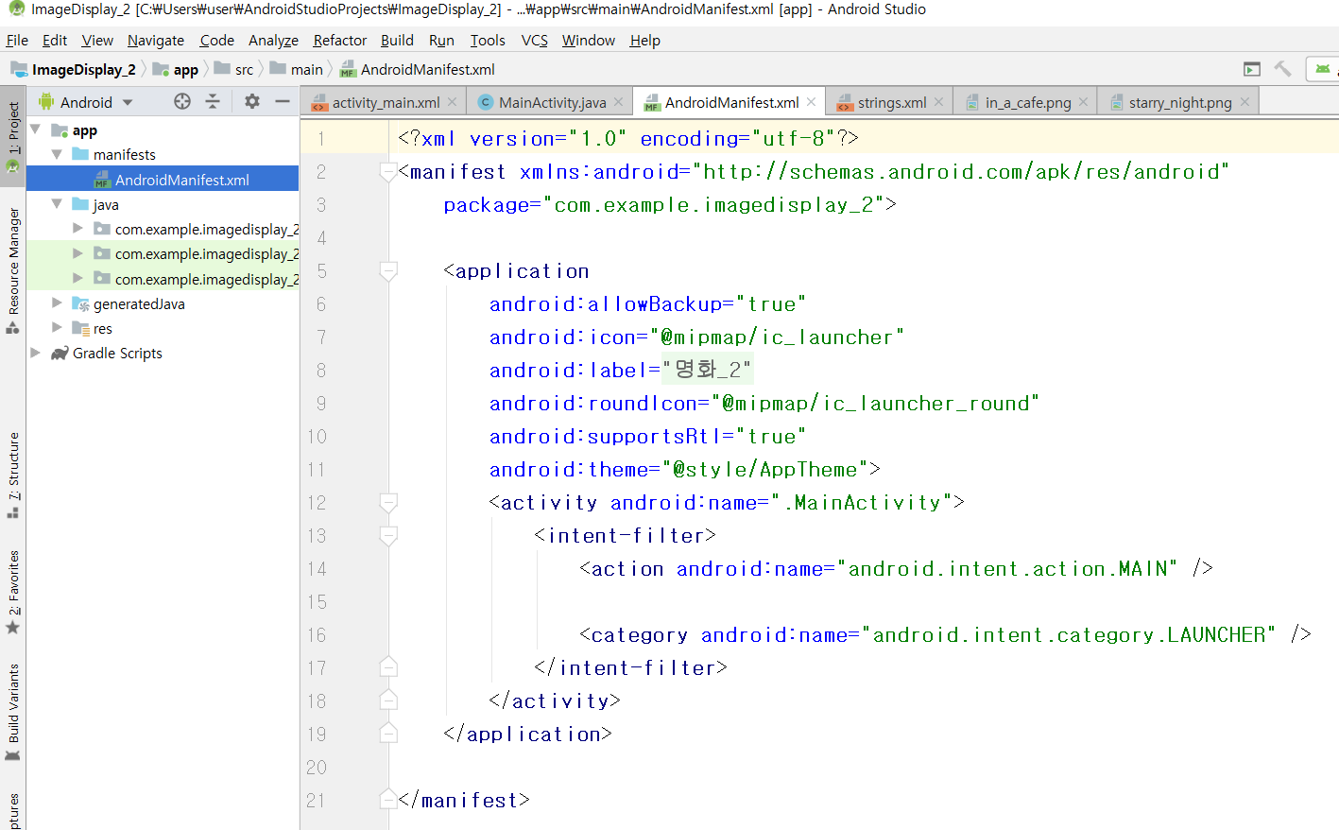
[AndroidManifest.xml]

Slide 22
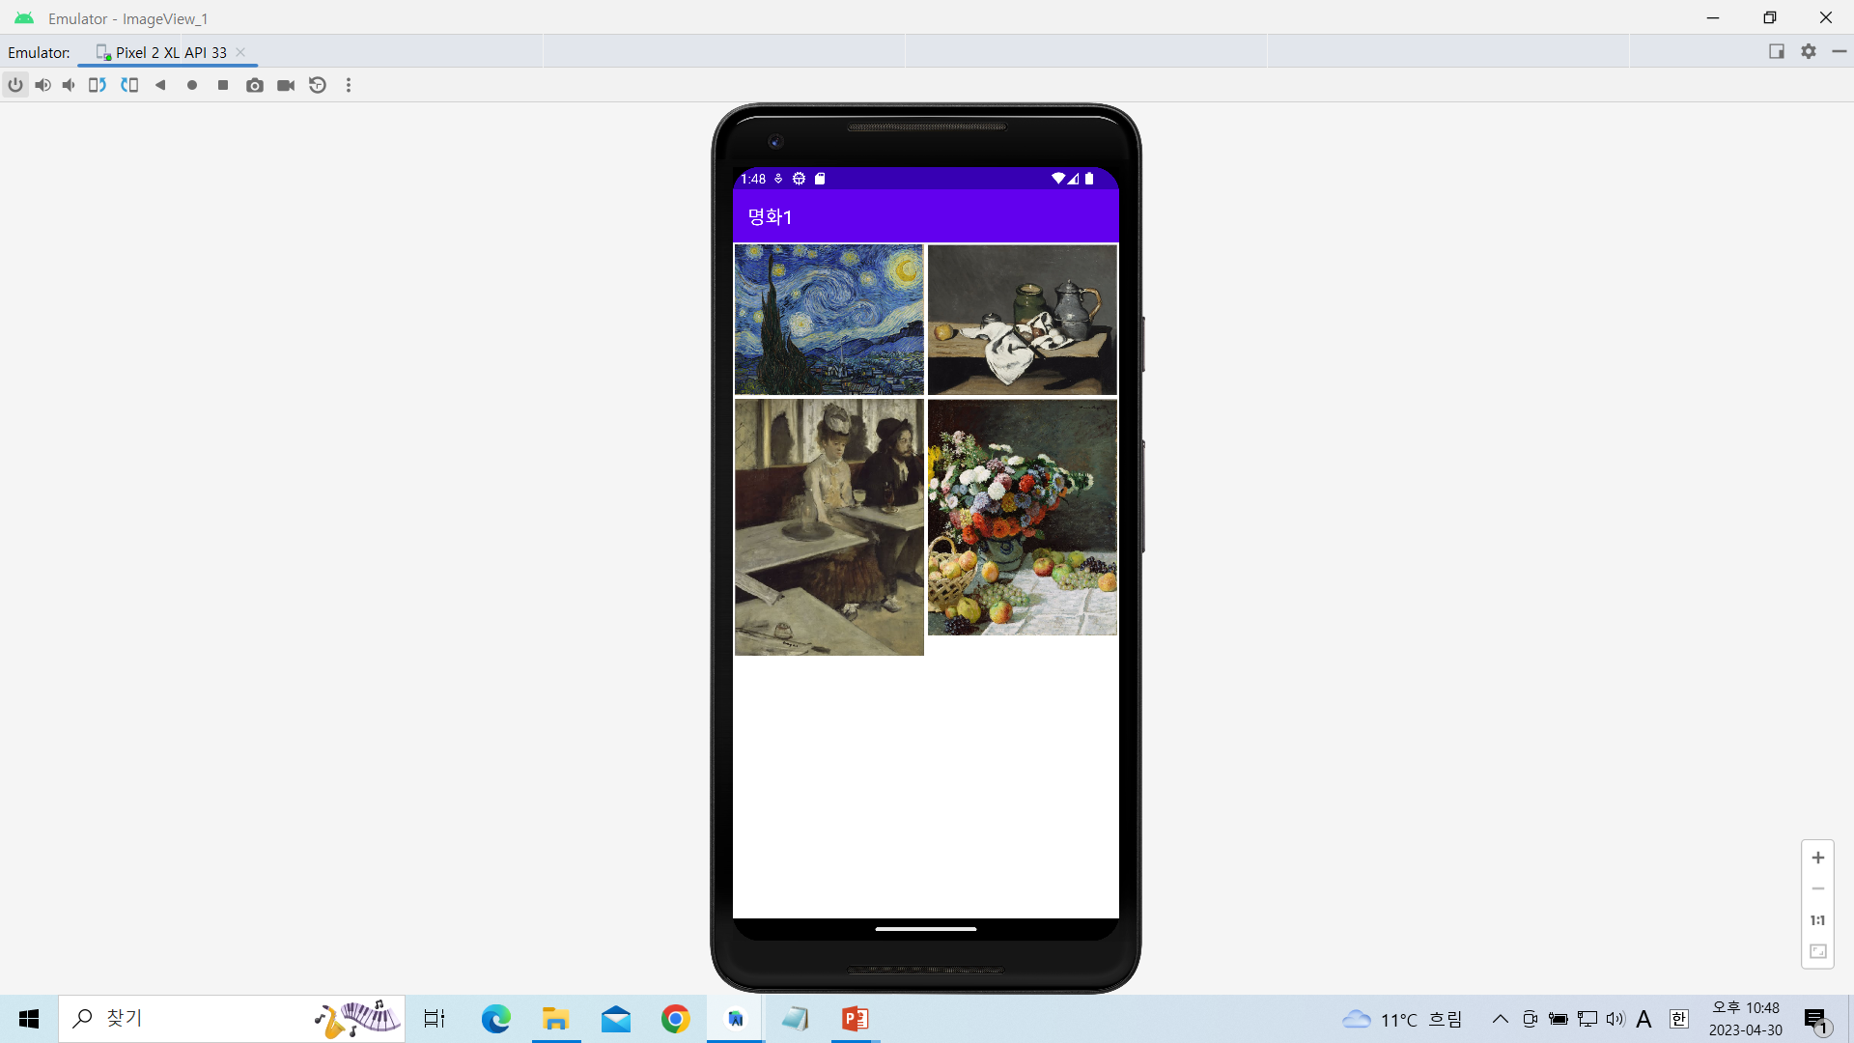
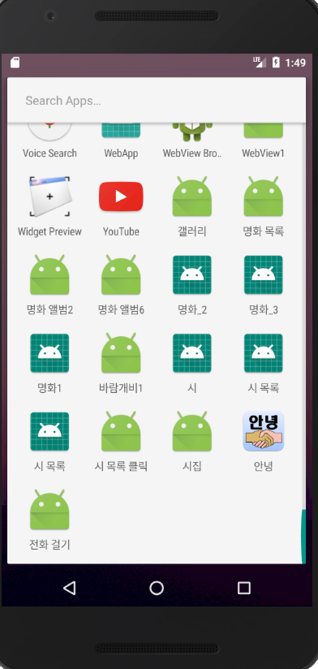
테이블 레이아웃을 이용한 이미지출력하기-3

Slide 23
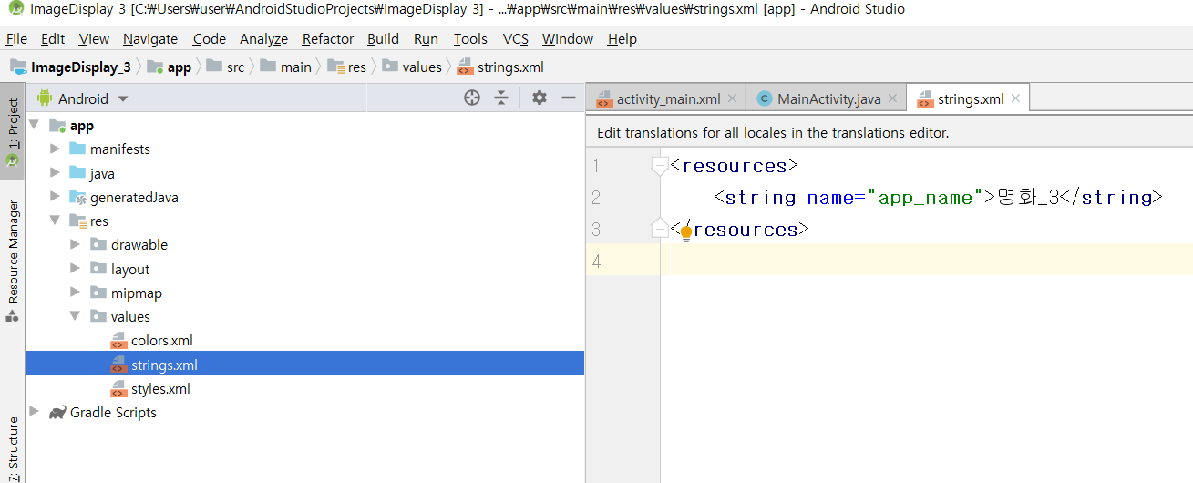
[strings.xml]
<resources>
<string name="app_name">명화_3</string>
</resources>

Slide 24
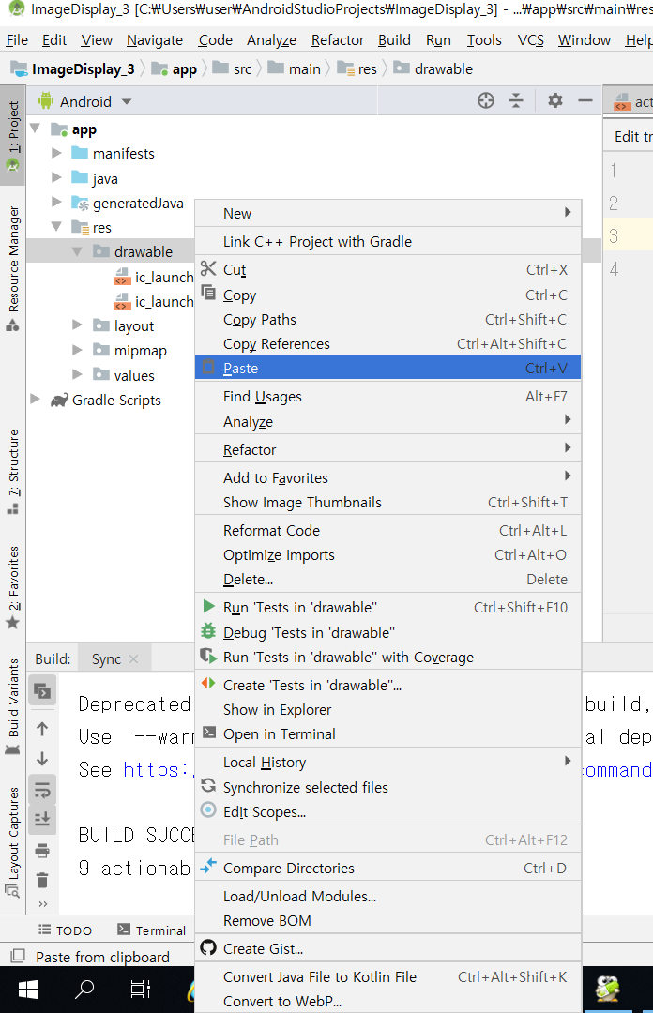
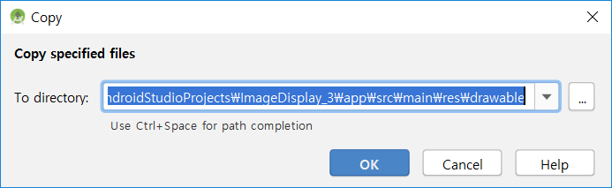

Slide 25
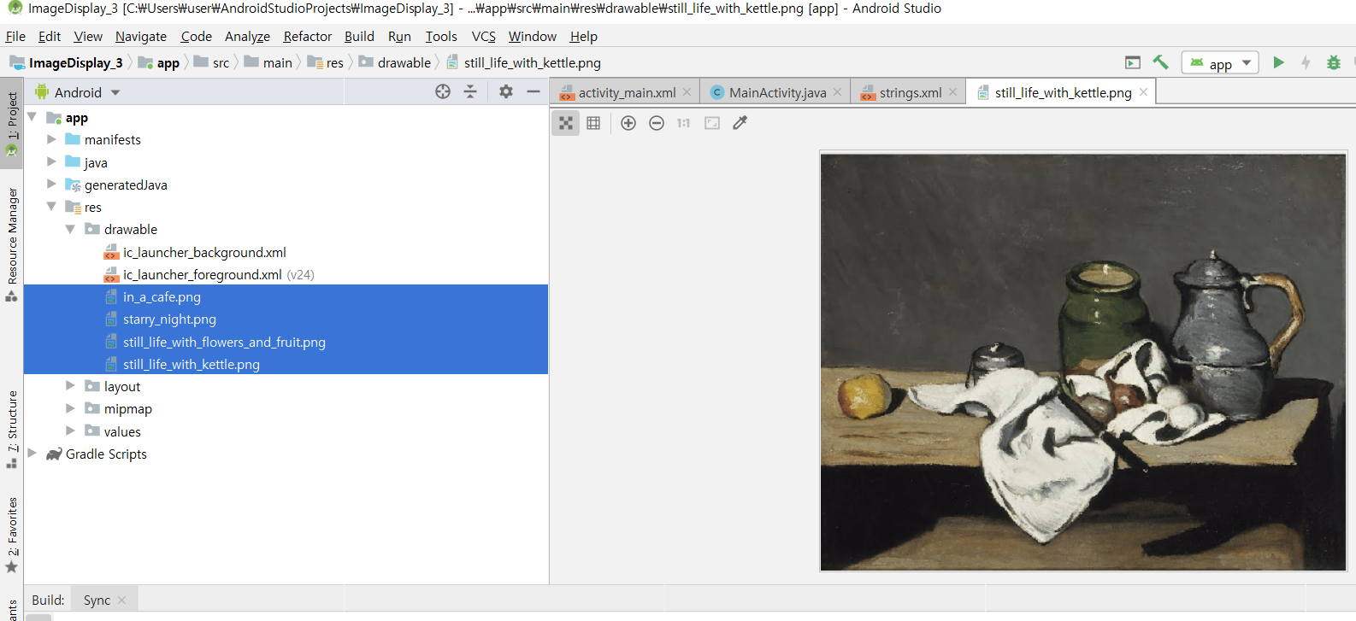

Slide 26
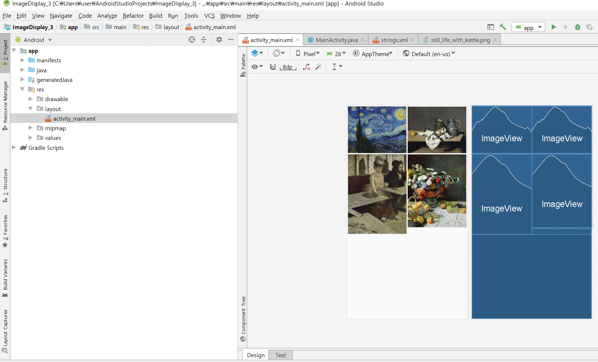
[activity_main.xml]

Slide 27
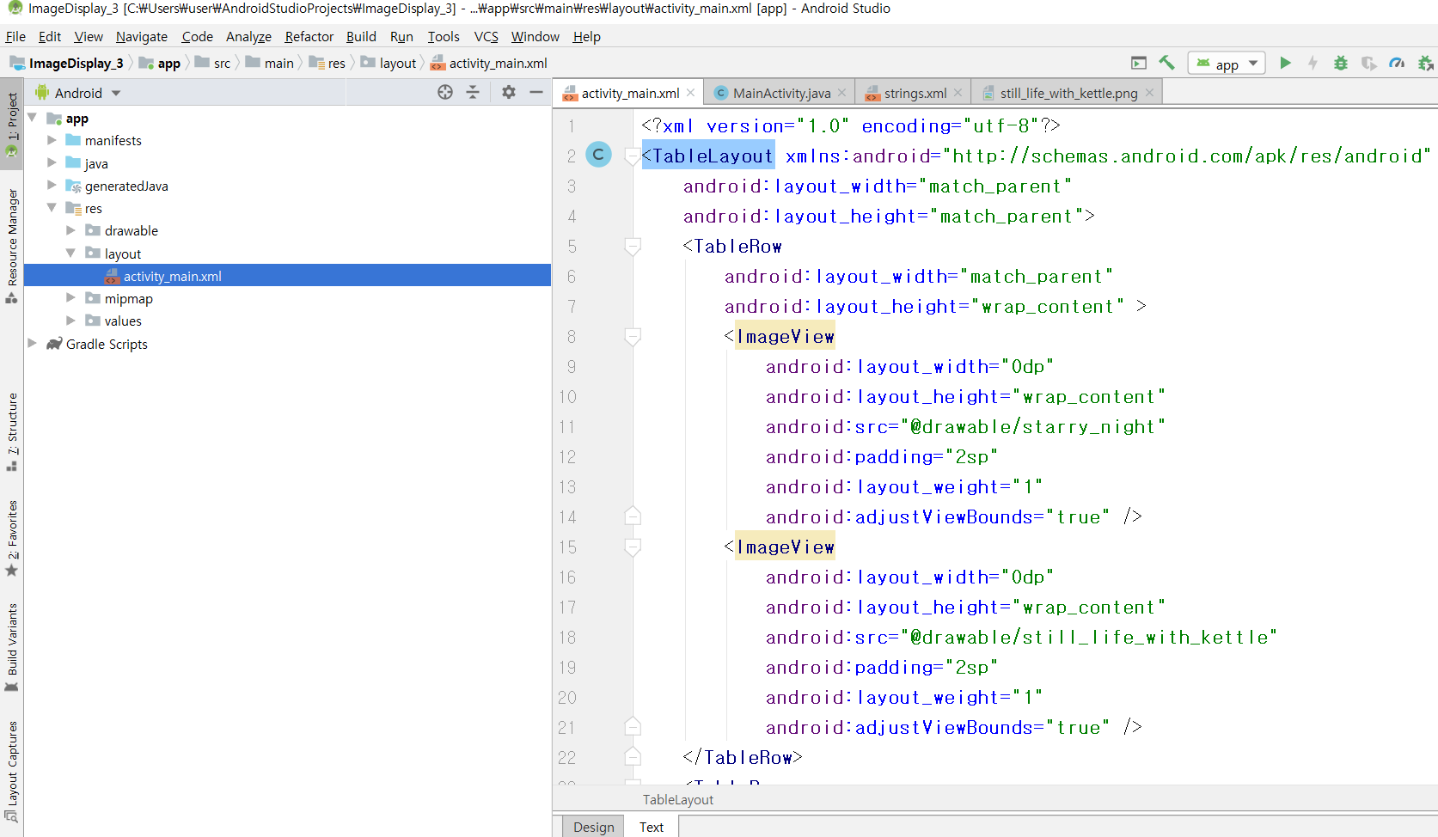

Slide 28
<?xml version="1.0" encoding="utf-8"?>
<TableLayout xmlns:android="http://schemas.android.com/apk/res/android"
android:layout_width="match_parent"
android:layout_height="match_parent">
<TableRow
android:layout_width="match_parent"
android:layout_height="wrap_content" >
<ImageView
android:layout_width="0dp"
android:layout_height="wrap_content"
android:src="@drawable/starry_night"
android:padding="2sp"
android:layout_weight="1"
android:adjustViewBounds="true" />
<ImageView
android:layout_width="0dp"
android:layout_height="wrap_content"
android:src="@drawable/still_life_with_kettle"
android:padding="2sp"
android:layout_weight="1"
android:adjustViewBounds="true" />
</TableRow>

Slide 29
<TableRow
android:layout_width="match_parent"
android:layout_height="wrap_content" >
<ImageView
android:layout_width="0dp"
android:layout_height="wrap_content"
android:src="@drawable/in_a_cafe"
android:padding="2sp"
android:layout_weight="1"
android:adjustViewBounds="true" />
<ImageView
android:layout_width="0dp"
android:layout_height="wrap_content"
android:src="@drawable/still_life_with_flowers_and_fruit"
android:padding="2sp"
android:layout_weight="1"
android:adjustViewBounds="true" />
</TableRow>
</TableLayout>

Slide 30
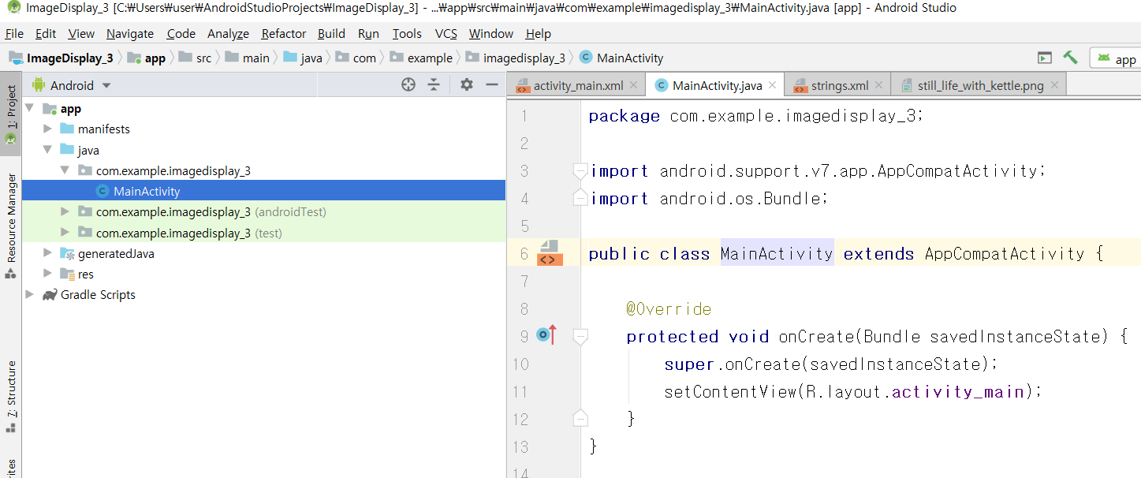
[MainActivity.java]

Slide 31
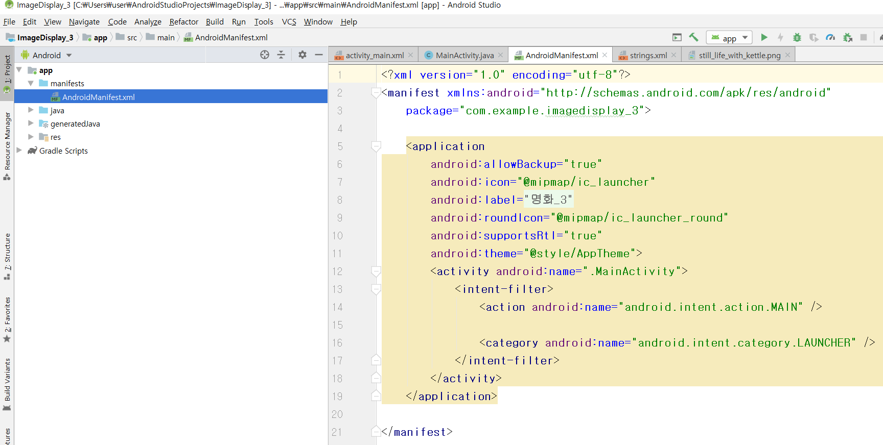
[AndroidManifest.xml]

